Slide 1

How Statistics Can Empower Your Research?
Xiayu (Stacy) Huang
Bioinformatics Shared Resource
Sanford | Burnham Medical Research Institute

Slide 2
Outline
Overview of basic statistics
  Brief Introduction
  Descriptive statistics
  Inferential statistics
Common statistical tests and applications
  Two sample unpaired T test
  Two sample paired T test
  One-way ANOVA
Notes:
Mention that the other topics can be covered next time

Slide 3

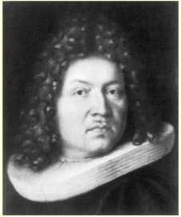
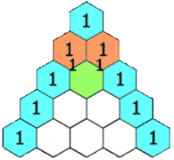
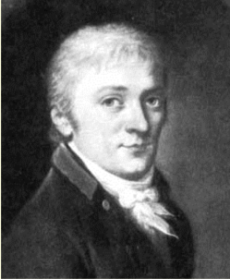
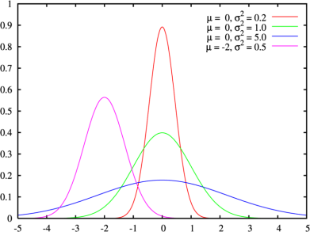
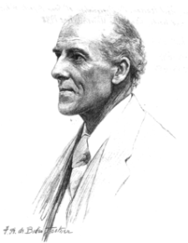
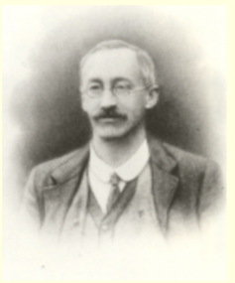
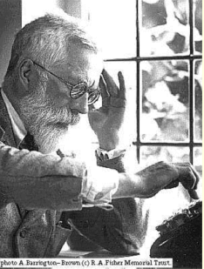
History of statistics
17th-18th century
19th century
20th century
Bernoulli number
Bernoulli trial
Bernoulli process, etc
Blaise Pascal
Jakob Bernoulli
Carl Friedrich Gauss
Karl Pearson
Standard deviation
Pearson correlation
Chi-square distribution
William Gosset
Student’s t
Ronald Aylmer Fisher
Experimental design
ANOVA, maximum likelihood
Nonparametric tests
Notes:
Statistics is the science of collecting, processing, interpreting and presenting numerical information
Pascal triangle: each number is the sum of two directly above it.

Slide 4



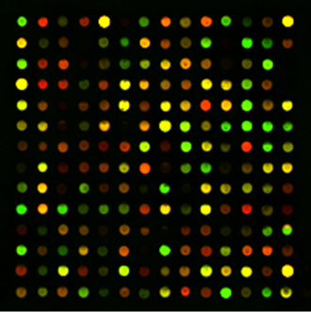
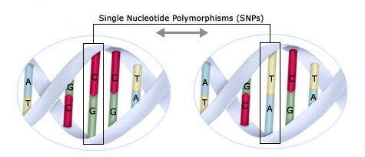
Why statistics is important to biologists?
Designing biological experiment needs statistics such as sample size and power calculation
Analyzing biological data i.e. microarray data, proteomics data, biological sequence data, genetics data (SNPs), etc. needs statistics
Publications and grant applications need statistics
How many ???
DEGs
Disease
Notes:
Statistical methods are beginning to be integrated into medical informatics, public health informatics, bioinformatics and computational biologyIf possible, provide statistics on the number of individuals affected by the disease process, debilitation, morbidity or mortality. Data Analysis Plan
One of the most common pitfalls of proposals is an insufficient or inappropriate data analysis plan (Baron, 1986). Perhaps some investigators are accustomed to collecting data first, then figuring out the data analysis strategy later. With grant proposals, you must have all data analysis strategies clearly planned so that a reviewer reading this section will have a clear picture of your entire project (Taylor, 1995). Make sure that each data analysis can appropriately test each hypothesis. Be sure to include a power analysis to justify your sample size and describe how you will minimize Type I and II errors. If appropriate, discuss how you will prevent contamination across treatment groups. Describe types of data to be obtained and statistical or power analysis if indicated.
Learning genetics of common, complex disorder is called genome wide association studies.

Slide 5
Some important concepts
Population and Sample
  A data sample is taken from a population
Parameter and statistics
  A parameter (i.e. µ, σ ) is a characteristic of the population
  A statistics (i.e. , s ) is a characteristic of the sample
For example:
Flip a coin 3 times
Sample = 3 flips
Population = All possible flips (infinite)
Notes:
A quantity such as measure of central tendency or a measure of dispersion is called a parameter when it describes or characterize a population, however by random sampling of populations, parameters can be estimated and an estimate of a population parameter is called a statistic

Slide 6
Variables
Continuous variable
  Having an infinite number of values such as gene expression values
Categorical variable
  Ordinal
    Obvious order to the categories. i.e. different dosages of medicine
  Nominal
    No obvious order to the categories. i.e. type of cancer, gender, race
Notes:
Categorical variable: observations are in categories: type of cancer

Slide 7
Types of statistics
Descriptive statistics
  Measure of central tendency, dispersion, association, etc.
  Usage of descriptive statistics
    Identify pattern
    Identify outliers
    Leads to hypothesis generating
Inferential statistics
  Hypothesis, type I and type II error, p-value, power
  Usage of inferential statistics
    Distinguish true difference from random variation
    Allows hypothesis testing
Notes:
descriptive statistics--can be classified into three groups, those that measure 1) central tendency or location of a set of numbers, 2) variability or dispersion, and 3) the shape of the distribution.

Slide 8
Measures of central tendency and dispersion
Measures of central tendency: mean, median and mode
Measures of dispersion
  Range and interquantile range (IQR)
    Range=maximum value-minimum value
    IQR=75th percentile-25th percentile (Q3-Q1)
  Variance
  Standard deviation (s)
  Standard error of mean (SEM)
Notes:
Standard deviaiton-tells you how your data is spread around the center.

Slide 9
Example 1-evaluaing a new treatment in a prostate cancer study
12 patients, males, ranging in age from 47 to 73
All diagnosed as prostate cancer stage 4
Participating in the study within 4 weeks of diagnosis
Subject # | 1 | 2 | 3 | 4 | 5 | 6 | 7 | 8 | 9 | 10 | 11 | 12
Survival time | 3 | 5 | 6 | 6 | 8 | 8 | 9 | 9 | 9 | 10 | 11 | 45

Slide 10
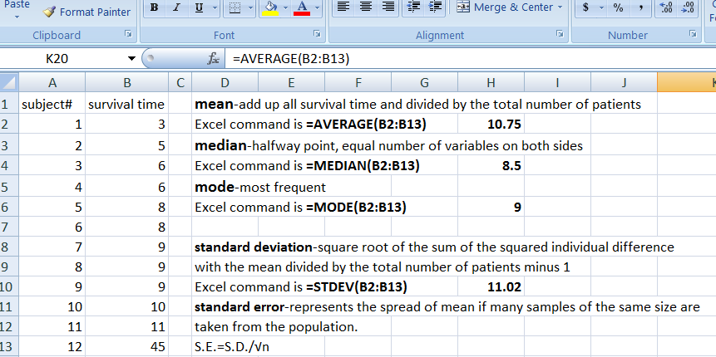
Calculating mean, median, mode and standard deviation in excel

Slide 11
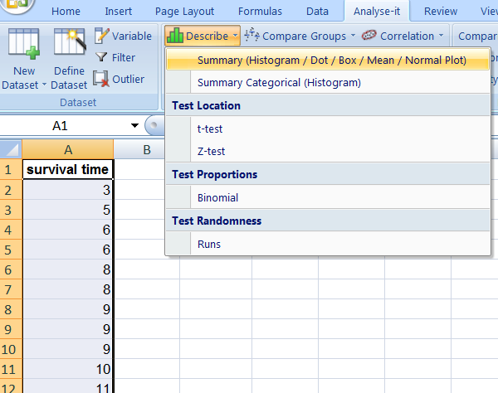
Calculating mean, median, mode and standard deviation in excel+ add-ins (Analyse-it)
http://www.analyse-it.com/products/standard

Slide 12
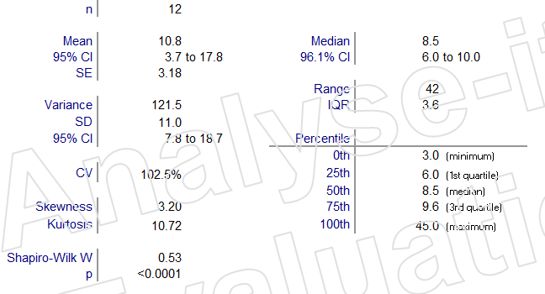
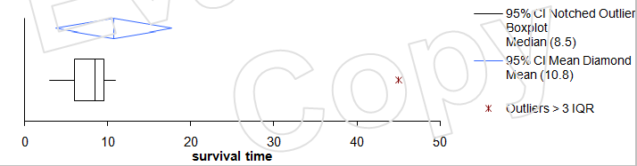
Result

Slide 13
Will they get funded?
Descriptive statistics | No treatment | New treatment
Mean | 9.6 | 10.8
Standard deviation | 3.2 | 11.0
After removing outlier
Descriptive statistics | No treatment | New treatment
Mean | 9.6 | 7.6
Standard deviation | 3.2 | 2.4

Slide 14
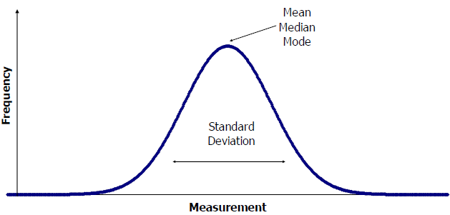
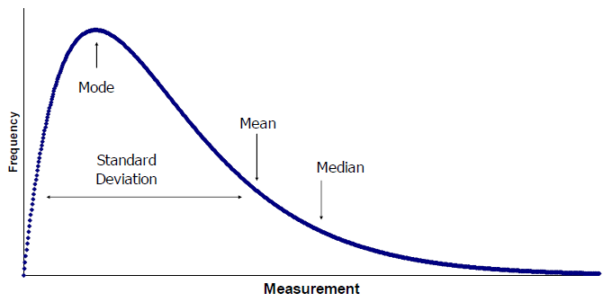
Choosing measure of central tendency and dispersion
Symmetric distribution
Asymmetric distribution
Symmetric distribution: mean and standard deviation
Asymmetric distribution: median and IQR

Slide 15
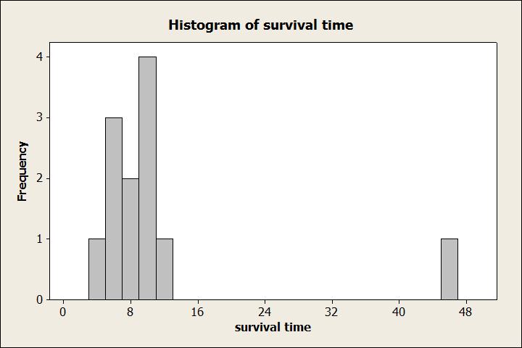
Choosing the right measurement
Descriptive statistics | No treatment | New treatment
Mean | 9.6 | 10.8
Standard deviation | 3.2 | 11
Median | 9.6 | 8.5
IQR | 3.7 | 3.8

Slide 16
Measure of association-pearson’s correlation
Family | Brother’s height | Sister’s height
1 | 71 | 69
2 | 68 | 64
3 | 66 | 65
4 | 67 | 63
5 | 70 | 65
6 | 71 | 62
7 | 70 | 65
8 | 73 | 64
9 | 72 | 66
10 | 65 | 59
11 | 66 | 62
Sister’s height
Bother’s height
Notes:
Association is any relationship between two quantities. Correlation refers to linear relationship between two quantities.

Slide 17
Outline
Overview of basic statistics
  Brief Introduction
  Descriptive statistics
  Inferential statistics
Common statistical tests and applications
  Two sample unpaired T test
  Two sample paired T test
  One-way ANOVA
Notes:
Mention that the other topics can be covered next time

Slide 18
Inferential statistics
Parametric
  Interval or ratio measurements
  Continuous variable
  Usually assumes data are normally distributed
Nonparametric
  Ordinal or nominal measurements
  Discreet variables
  Makes no assumption about how data is distributed
Notes:
Can your experiment make a statement about the general population?

Slide 19
Inferential statistics-hypothesis
Null hypothesis (H₀)
Alternative hypothesis (H_{A})
Notes:
Null Hypothesis : Statistical hypotheses usually assume no relationship between variables. There is no association between eye color
and eyesight. If the result of your statistical test is significant, then the original hypothesis is false and you can say that the variables in your experiment are somehow related.

Slide 20
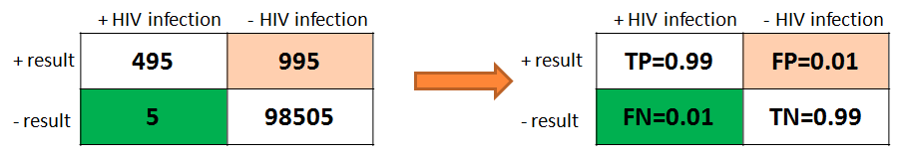
Inferential statistics-Error
Type I error (α, aka false positive rate (FP))
  Probability of incorrectly conclude a difference exists when one does not
Type II error (β, aka false negative rate (FN))
  Probability of failing to find a difference when a true difference exists
Notes:
Type I error: probability of incorrectly conclude a difference exists when one does not
Type II error: probability of failing to find a difference when a true difference exists
False positive rate (α) = FP / (FP + TN) = 18 / (18 + 182) = 9% = 1 − specificity
False negative rate (β) = FN / (TP + FN) = 1 / (2 + 1) = 33% = 1 − sensitivity
Power = sensitivity = 1 − β

Slide 21
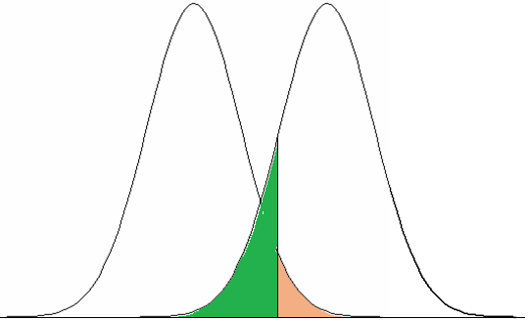
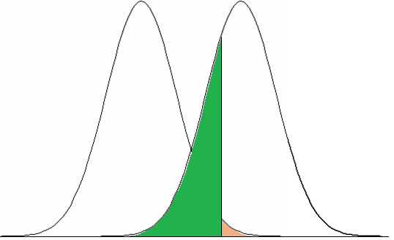
Relationship between FP rate and FN rate
HIV negative HIV positive
HIV negative HIV positive
Decreasing FP rate
FN rate
FP rate
FN rate
FP rate

Slide 22
Inferential Statistics-P-value
the probability that an observed difference could have occurred by chance
P-value is the same as false positive rate
P-value can help us decide if an observed difference is due to chance alone
The research chooses an arbitrary cut off (usually 0.05) to reject the null hypothesis
P-value below cut off is referred as “statistically significant”.

Slide 23
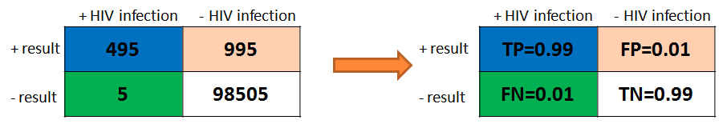
Inferential Statistics-Power
power (1-β, aka true positive rate (TP))
  Probability of detecting a significant scientific difference when it does exist
Notes:
The ability to detect a significant scientific difference when it does exist

Slide 24
Inferential Statistics-Power
Power depends on:
  Sample size (n)
  Standard deviation (σ or s)
  Size of the difference you want to detect (δ)
  False positive rate (α)
The sample size is usually adjusted to make power equal 0.8

Slide 25
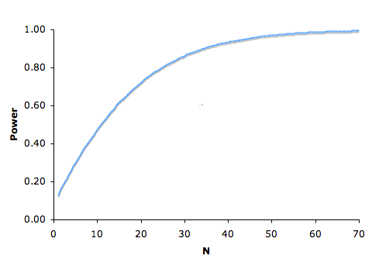
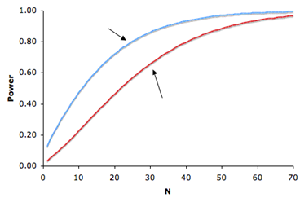
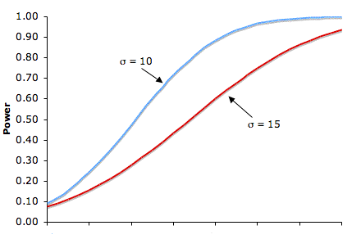
Relationship between power and its affecting factors
FP rate=0.05
0.76
N=24
FP rate=0.01
N=21
Power increases as:
sample size increases
FP rate increases
detectable difference increases
standard deviation decreases
1 2 3 4 5 6 7
δ

Slide 26
Hypothesis testing
Writing hypothesis
  H₀ : parameter1=parameter 2 or µ1= µ2
  H_{A} : parameter 1≠, > or < parameter 2
Choosing model or test and calculating test statistic
  Choosing model and checking assumptions
  Calculating test statistic such as Z-score, T-score, F-score, etc
Finding a p-value
  Obtaining p-value based on your observed test statistic
  Compare p-value with prefixed type I error (α)
Giving conclusion
  If p-value > α, fail to reject the null hypothesis
  If p-value < α, reject null hypothesis and favor alternative hypothesis
Notes:
The null hypothesis is the hypothesis that states that there is no relation between the phenomena whose relation is under investigation, or at least not of the form given by the alternative hypothesis. The alternative hypothesis, as the name suggests, is the alternative to the null hypothesis: it states that there is some kind of relation. The alternative hypothesis may take several forms, depending on the nature of the hypothesized relation; in particular

Slide 27
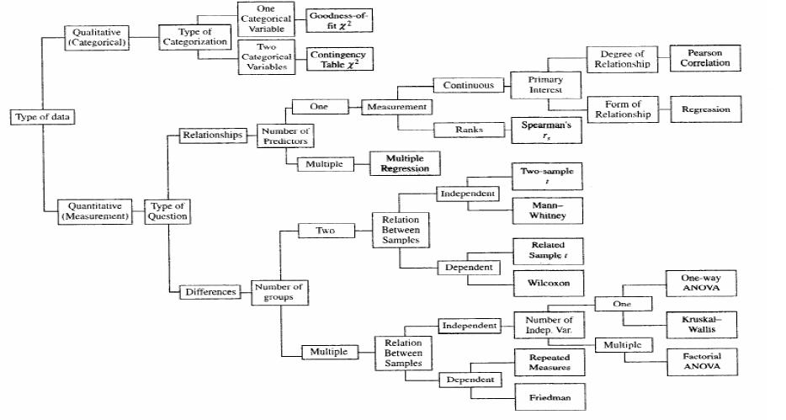
Choosing tests-decision tree

Slide 28
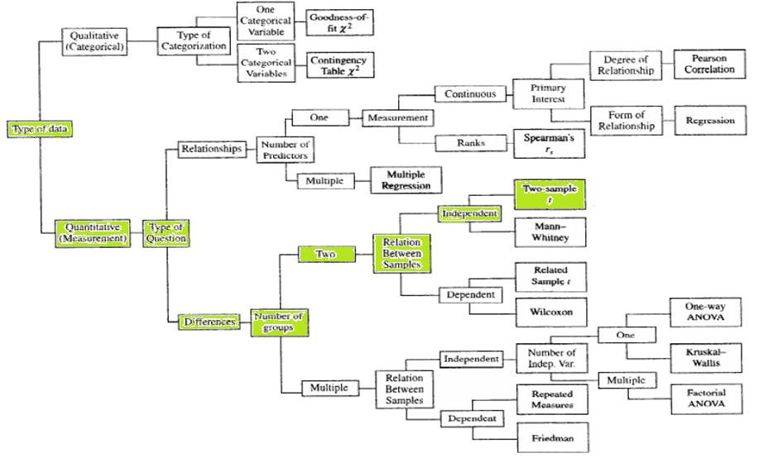
Two sample t test-decision tree

Slide 29
Outline
Overview of basic statistics
  Brief Introduction
  Descriptive statistics
  Inferential statistics
Common statistical tests and applications
  Two sample unpaired T test
  Two sample paired T test
  One-way ANOVA
Notes:
Mention that the other topics can be covered next time

Slide 30
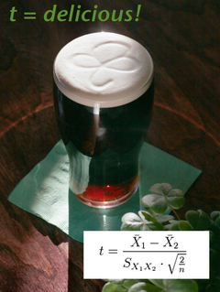
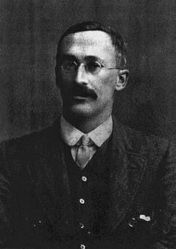
Student’s t test
Guinness employee William Sealy Gosset published the 'Student's t-test' in 1908

Slide 31
Common statistical tests-two sample unpaired t test
  Assumptions:
    The underlying distribution is normal or approximate normal
    The sample has been independently and randomly selected
    The variability of the two populations can be measured by a common
    variance
  Hypothesis
  Test statistic
-- sample means
-- population means
-- sample standard deviation
-- sample size
-- pooled sample variance

Slide 32
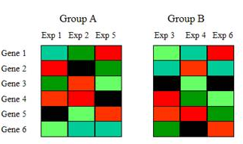
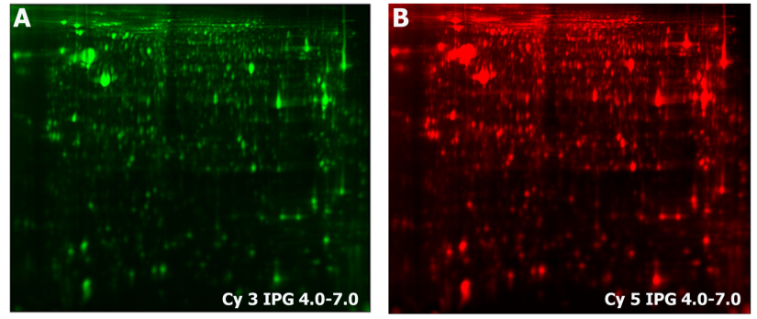
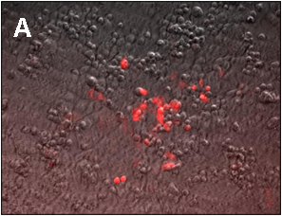
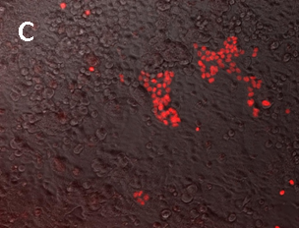

application of two sample unpaired t test in biology
1. microarray
2. proteomics
experiment control
3. image analysis
4. power and sample size calculation
How many???
Notes:
Is mean expression level of a gene in group A significantly different from mean expression level in group B?

Slide 33
Common statistical tests-two sample paired t test
  Assumptions:
    One to one correlation for observations in the two comparison groups
    The difference from each pair of observations follows a normal distribution
  Hypothesis
  Test statistic
-- sample mean difference
-- population mean difference
-- sample standard deviation of difference
-- number of pairs

Slide 34
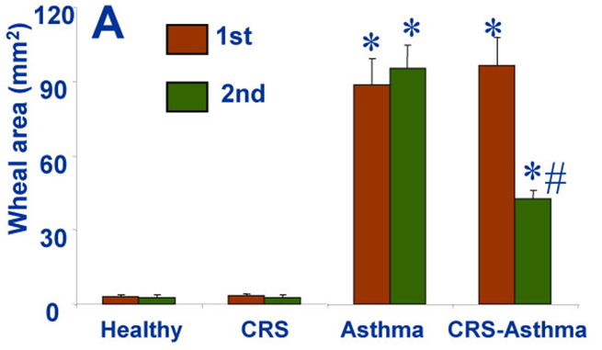
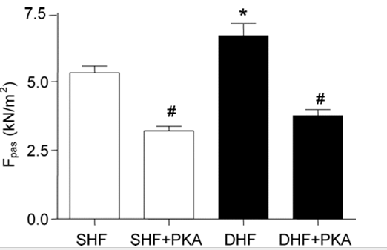
Application of two sample paired t test in biology
Notes:
Chronic rhinosinusitis
Pre/post or pretest.posttest. Paired sample t-test is used in ‘before after’ studies, or when the samples are the matched pairs, or the case is a control study. Subjects are often tested in a before-after situation (across time, with some intervention occurring such as a diet), or subjects are paired such as with twins, or with subject as alike as possible
Assumptions in Paired sample t-test:
1.The first assumption in the paired sample t–test is that only the matched pair can be used to perform the paired sample t-test.
2.In the paired sample t-test, normal distributions are assumed.
3.Variance in paired sample t-test: In a paired sample t-test, it is assumed that the variance of two samples is same.
4.Independence of observation in paired sample t-test: In a paired sample t-test, observations must be independent of each other.

Slide 35
Example 2
H₀ : there is no drug effect in the number of years’ remission from cancer
Patient pair | GrpA-Drug | GrpB-Placebo | Difference
1 | 7 | 4 | 3
2 | 5 | 3 | 2
3 | 2 | 1 | 1
4 | 8 | 6 | 2
5 | 3 | 2 | 1
6 | 4 | 4 | 0
7 | 10 | 9 | 1
8 | 7 | 5 | 2
9 | 4 | 3 | 1
10 | 9 | 8 | 1
mean | 5.9 | 4.5 | 1.4
STD | 2.69 | 2.55 | 0.84

Slide 36
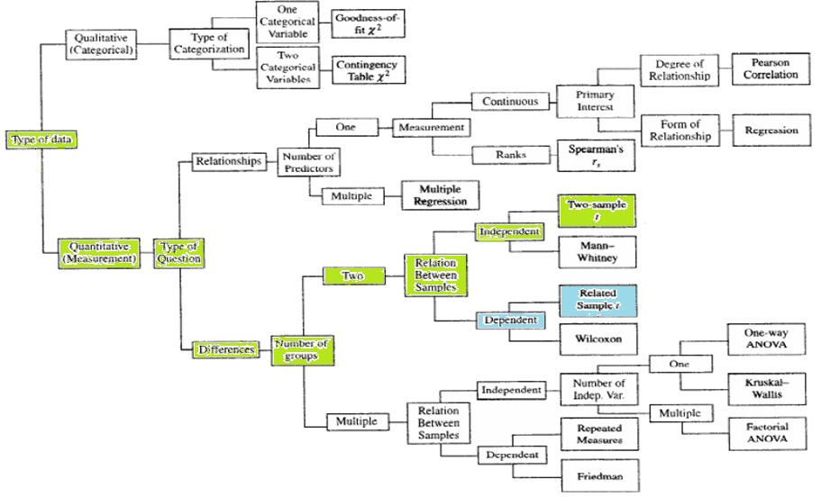
Two sample t test-decision tree

Slide 37
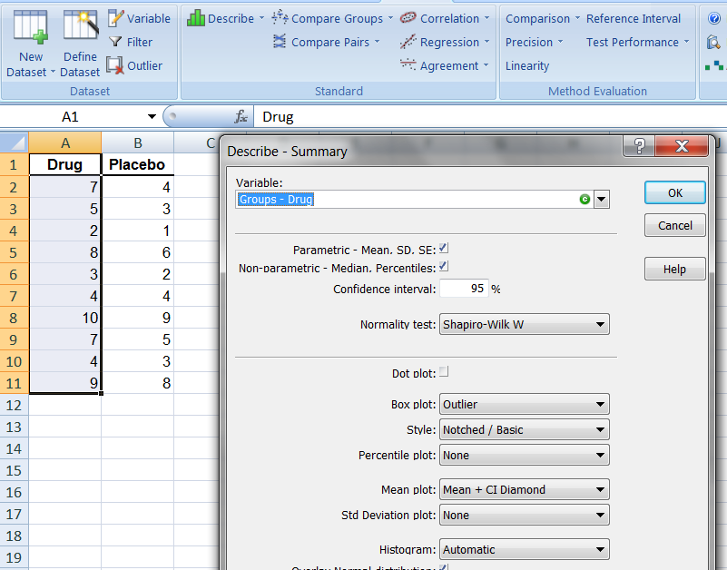
Normality check-unpaired t test

Slide 38
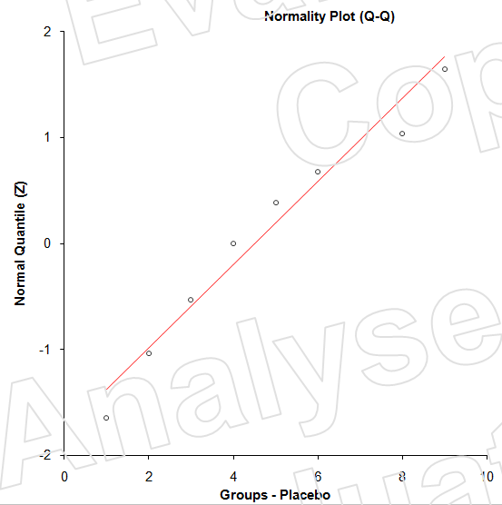
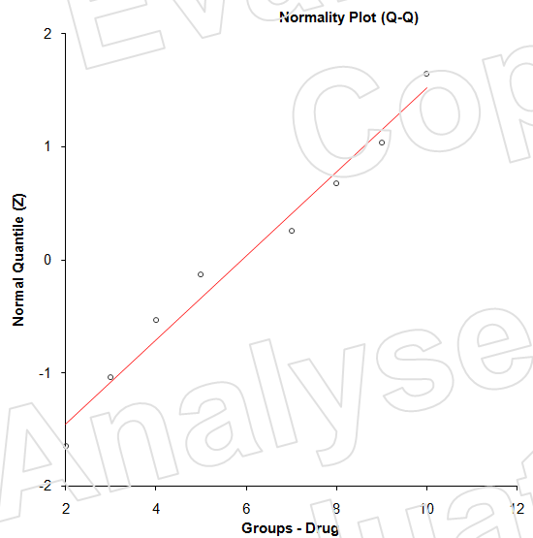
Result-unpaired t test
Group | Shapiro-wilk test | P value
Placebo | 0.95 | 0.660 (not significant)
Drug | 0.95 | 0.718 (not significant)

Slide 39
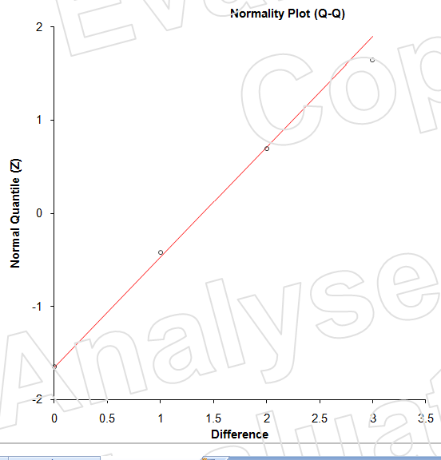
Result-paired t test
Shapiro-wilk test | P value
0.89 | 0.172 (not significant)

Slide 40
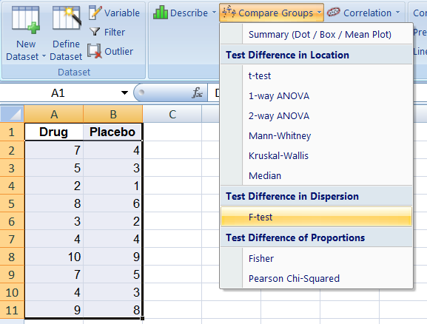
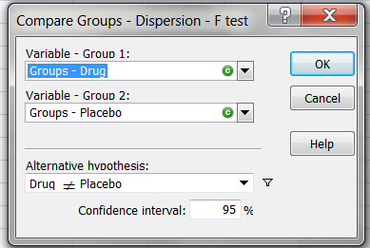
Equal variance check

Slide 41
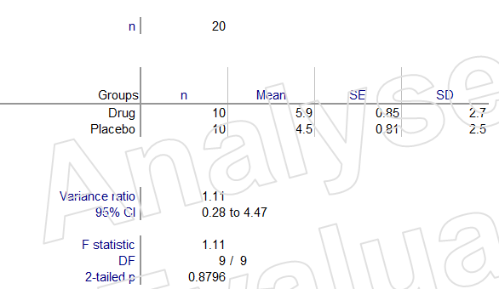
Equal variance check
P-value=0.8796 is not significant, which indicates the variances of the two groups are similar

Slide 42
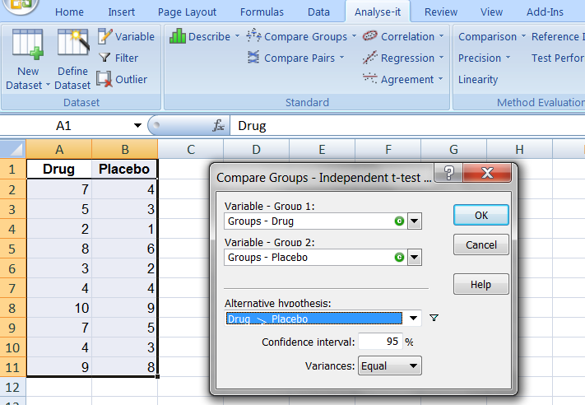
Two sample unpaired t test

Slide 43
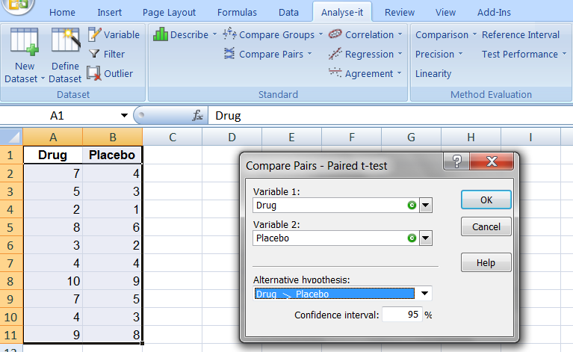
Two sample paired t test
Notes:
Define the data set as list

Slide 44
Two sample unpaired t test and paired t test
Type of test | T statistic | d.f. | One tail p-value | Power
unpaired t test | 1.2 | 18 | 0.13 | 0.31
Paired t test | 5.25 | 9 | 3E-4 | 0.99
Results are completely different by choosing different test
Paired t test is the right one to use

Slide 45
Common statistical tests-one way anova
ANOVA (analysis of variance)
  Compares the means of 3 or more groups
  Assumptions:
    Sampling should be independent and randomized.
    Sample size of each group is similar.
    Standard deviation of each group is similar
    Data is normally distributed.
  Post-Hoc test
Ronald Aylmer Fisher, ANOVA, 1918

Slide 46
Most commonly used post-hoc anova
Method | Equal N | Normality | Equal variance | Error control | Protection
Fisher PLSD | yes | yes | yes | All | Most sensitive to type I
Tukey-Kramer HSD | no | yes | yes | All | Less sensitive to type I than Fisher PLSD
Spjotvoll-Stoline | no | yes | yes | All | As Tukey-Kramer
Student-Newman Keuls (SNK) | yes | yes | yes | all | Sensitive to type II
Tukey-Compromise | no | yes | yes | all | Average of Tukey and SNK
Duncan’s Multiple Range | no | yes | yes | all | More sensitive to type I than SNK
Scheffe’s S | yes | no | no | all | Most conservative
Games/Howell | yes | no | no | all | More conservative than majority
Dunnett’s test | no | no | no | T/C | More conservative than majority
Bonferroni | no | yes | yes | All, TC | conservative
http://eprints.aston.ac.uk/9317/1/Statnote_6.pdf

Slide 47
Example 3-mice: lifetime vs. diet
Treatment | N/N85 | N/R50 | R/R50 | N/R50_lopro | N/R40
Life time | 42.3 | 49.7 | 49.1 | 50.7 | 54.6
 | 40.1 | 49.3 | 48.7 | 50.6 | 54
 | 39.5 | 48.6 | 48.3 | 50.5 | 53.8
 | 38.6 | 48.3 | 48.1 | 50.3 | 53.3
 | 38.4 | 48 | 48 | 50.1 | 52.9
Journal of Nutrition 116(4) (1986): 641-54

Slide 48
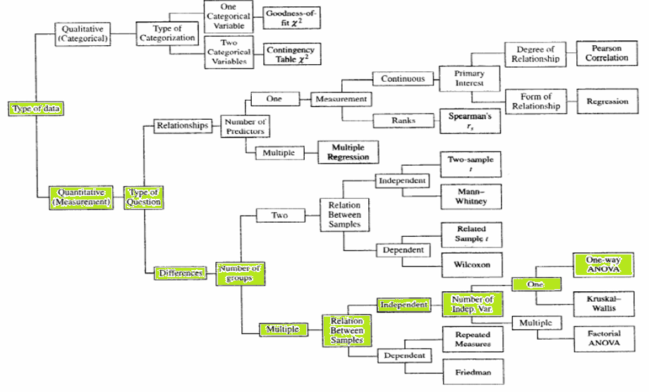
One way anova-decision tree

Slide 49
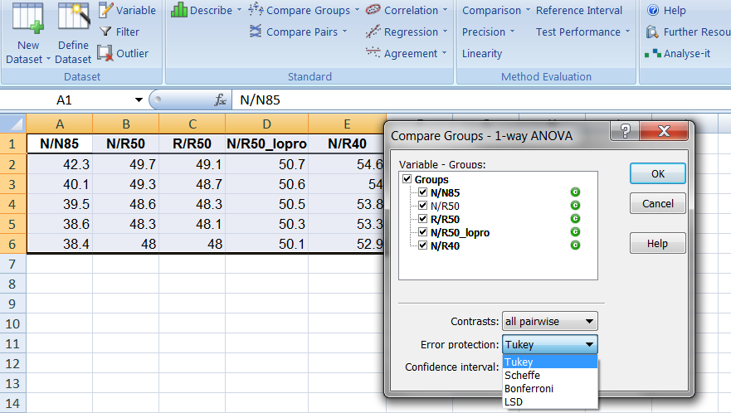
One way anova analysis in excel+add-ins (analyze-it)

Slide 50
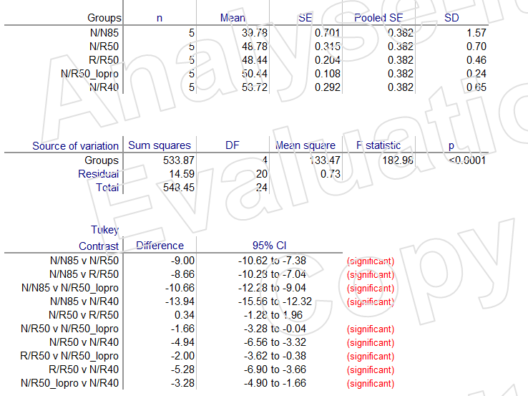
Result

Slide 51
Summary
Descriptive statistics
  Measure of central tendency, dispersion, & association
Inferential statistics
    Hypothesis, errors, p-value, power
Three statistical tests and their applications
  Two sample unpaired test, paired t test and one way ANOVA
    Assumptions and assumptions check in excel

Slide 52
Basic Statistics tools
Statistics softwares and packages:
1.Excel and add-ins: XL Statistics, Analyze-it , EZAnalyze, Analysis Toolpak
2. Prism (available for the whole Sanford-Burnham), minitab
3. SAS
4. Hmisc, Pastecs, psych, pwr, etc. in R
Basic statistics books:
1. Intro Stats, SDSU, 2nd edition, Deveaux, Velleman, Bock
2. Choosing and Using Statistics: A Biologist's Guide
3. Introduction to Statistics for Biology
Statistics videos:
1. http://www.microbiologybytes.com/maths/videos
2. http://www.youtube.com: descriptive statistics, basic statistics,
install 2007 Excel data analysis add-ins…
Notes:
Descriptive Statistics ,The Normal Frequency Distribution, Correlation, Regression, Standard Scores (z Scores), Student's t-test, Chi square test
Microsoft Excel Analysis ToolPak

Slide 53

Thank You All for Coming and Cheers!!!

Slide 54
Questions?

