Slide 1
Bioinformatics Shared Resource Introduction to Gene Expression Omnibus (GEO)
http://www.youtube.com/ncbinlm
bsrweb.sanfordburnham.org
Notes:
What will most likely be your interaction with GEO? Deposit expression data (a billion already deposited), download data, mine data for differentially expressed genes.
A very inclusive data base with 100s of organisms and many many many different types of biological investigations
Makes available some quite powerful computing tools.

Slide 2
GEO Database: www.ncbi.nlm.nih.gov/geo
Public repository that archives and distributes expression data
Microarray data and Next-gen Sequencing Data; RNA-seq
User-friendly Web based tools to explore data
Approximately a billion measurements recorded and available to search
100 organisms and thousands of different expression analysis platforms
GEO expression data submission
Pre-requisite for publications including expression data
Step by step web deposit
Proper preparation of sample data spreadsheets and submission forms
GEO query
Use search terms (text) to locate relevant DataSets or gene profiles
Search for and download complete sets of data (including raw array data)
Provides on-the-fly data analysis using the built in R stats tools (interesting!)
bsrweb.sanfordburnham.org

Slide 3
GEO database structure
The data is carefully structured around
- platforms - the array type
- samples - the single sample on a chip
-series - the grouping of samples
These are the basic building blocks of GEO

Slide 4
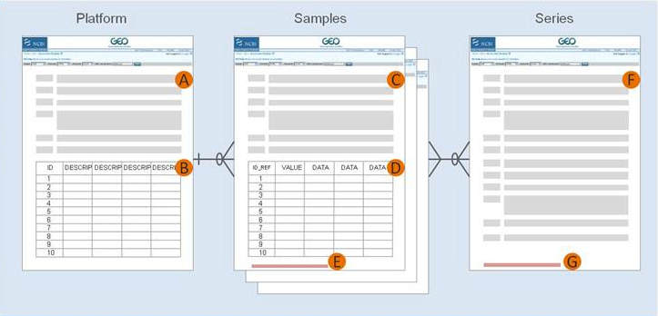
Linked data tables make a GEO record
The samples grouped
to make a Series or
DataSet
Affymetrix chip GPL570
HG-U133plus2
Time point at X hrs
Notes:
The data is carefully structured around
- platforms - the array type
- samples - the single sample on a chip
-series - the grouping of samples
These are the basic building blocks of GEO
Platform records are supplied by submitters
A Platform record is composed of a summary description of the array or sequencer and, for array-based Platforms, a data table defining the array template.Each Platform record is assigned a unique and stable GEO accession number (GPLxxx). A Platform may reference many Samples that have been submitted by multiple submitters. Example Platform record »
A Text description of the array or sequencer B Text tab-delimited table of the array template Sample Sample records are supplied by submitters
A Sample record describes the conditions under which an individual Sample was handled, the manipulations it underwent, and the abundance measurement of each element derived from it. Each Sample record is assigned a unique and stable GEO accession number (GSMxxx). A Sample entity must reference only one Platform and may be included in multiple Series. Example Sample record »
C Text description of the biological sample and protocols to which it was subjected D Text tab-delimited table of processed hybridization result (may optionally include raw data columns) E Original raw data file, or processed sequence data file Series Series records are supplied by submitters
A Series record links together a group of related Samples and provides a focal point and description of the whole study. Series records may also contain tables describing extracted data, summary conclusions, or analyses. Each Series record is assigned a unique and stable GEO accession number (GSExxx). Example Series record »
F Text description of the overall experiment G Tar archive of original raw data files, or processed sequence data files

Slide 5
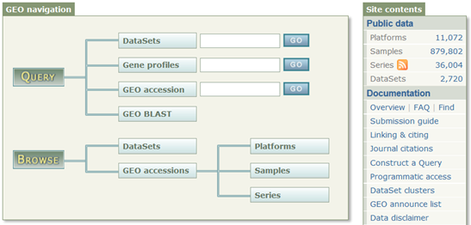
How to find data in GEO
http://www.ncbi.nlm.nih.gov/geo/
Study level
Gene Level
GDS4165
Exp profiles of homologs
Curated DataSets
The Complete Lists
Notes:
Enter “smoke” into DataSets box.
Query and Analysis
GEO data can be retrieved and analyzed in several ways:
To look at a particular GEO record for which you have the accession number, use the GEO accession box located on the GEO homepage or at the top of each GEO record.
To download data, see the various options described on the Download GEO data page.
To quickly locate data relevant to your interests, search GEO DataSets and GEO Profiles:
GEO DataSets is a study-level database which users can search for studies relevant to their interests. The database stores descriptions of all original submitter-supplied records, as well as curated DataSets. More information about GEO DataSets and how to interpret GEO DataSets results pages can be found on the About GEO DataSets page.
GEO Profiles is a gene-level database which users can search for gene expression profiles relevant to their interests. More information about GEO Profiles and how to interpret GEO Profiles results pages can be found on the About GEO Profiles page.
GEO DataSet and GEO Profiles searches may be effectively performed by simply entering appropriate keywords and phrases into the search box. However, given the large volumes of data stored in these databases, it is often useful to perform more refined queries in order to filter down to the most relevant data. Examples and full details about how to perform sophisticated queries are provided in the Querying GEO DataSets and GEO Profiles page. Additionally, the Limits and Advanced Search tools, linked at the head of the GEO DataSets and GEO Profiles pages, assist greatly in the construction of complex queries:
GEO DataSets Limits Query Builder
GEO DataSets Advanced Search
GEO Profiles Limits Query Builder
GEO Profiles Advanced Search
Once you have identified a DataSet of interest there are several features on the DataSet record that help identify interesting gene expression profiles within that study, including a t-test tool and clusters. Full information about these features is provided on the About GEO DataSets page.
Once you have identified gene expression profiles of interest there are several links on the Profile records that help identify additional genes of interest, including similarly expressed genes or genes within close proximity on the chromosome. Full information about these links is provided on the About GEO Profiles page.

Slide 6
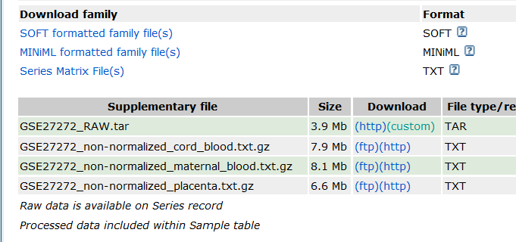
After locating data: download
ALL data and files, inc platform
ALL data and files in XML
values of the expression data
WARNING! These formats can be inconsistent
reliable approach: download the RAW files (chp files
for Affy, idat for illumina) and reprocess them
Notes:
SOFT – ALL data and files, inc platform
Minimal – XML based files
Series Matrix – primarily the values of the expression data
WARNING! These formats can be inconsistent
The most reliable approach is to download the RAW files (chp files for Affy, idat for illumina) and reprocess them.

Slide 7
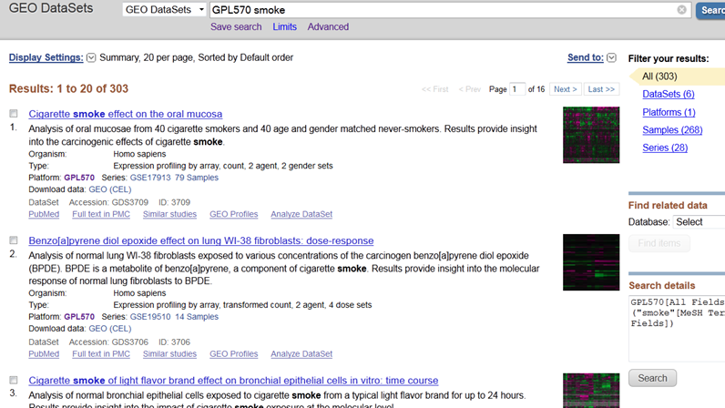
Key words in Search box
Notes:
The searching capabilities in GEO are quite powerful

Slide 8
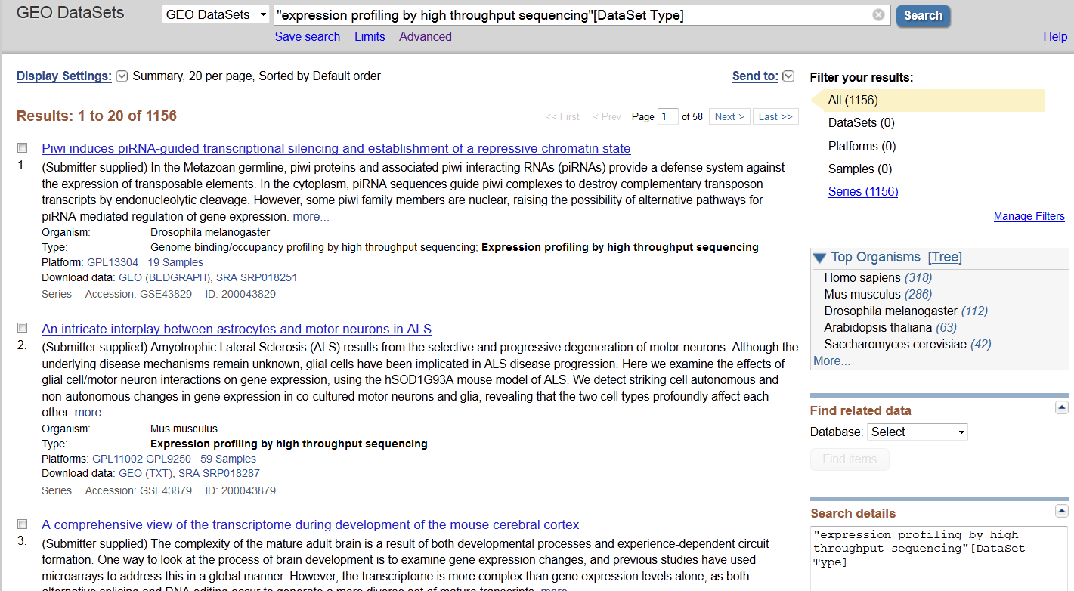
Study type in Search box

Slide 9
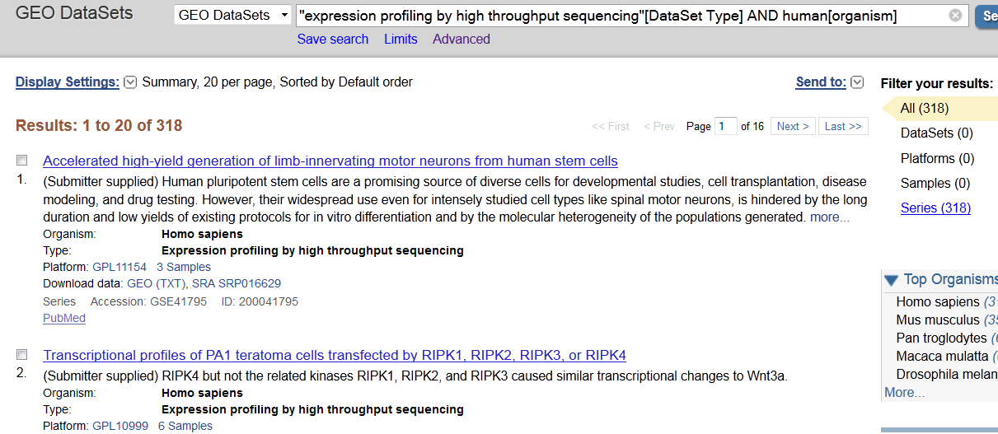
Select by Study Type and Organism
Link to short read archive
Compressed txt files
Notes:
What we have here now are the 318 studies in GEO using RNA seq to look at human samples, you can see the links to the Short Read Archive

Slide 10
GEO DataSet Analysis Tools
Compare 2 sets of samples (T-tests)
Precomputed Cluster Heatmaps
R analysis for differentially expressed genes
LIVE DEMO!!!!

Slide 11
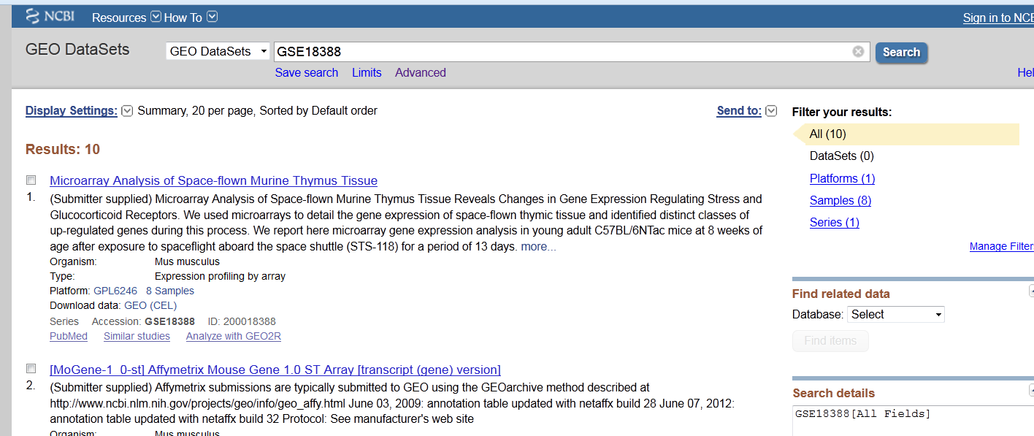
GEO2R: Analyze GEO microarray Data
retrieve a list of differentially expressed genes
Use search to find datasets of interest
Notes:
Go LIVE!

Slide 12
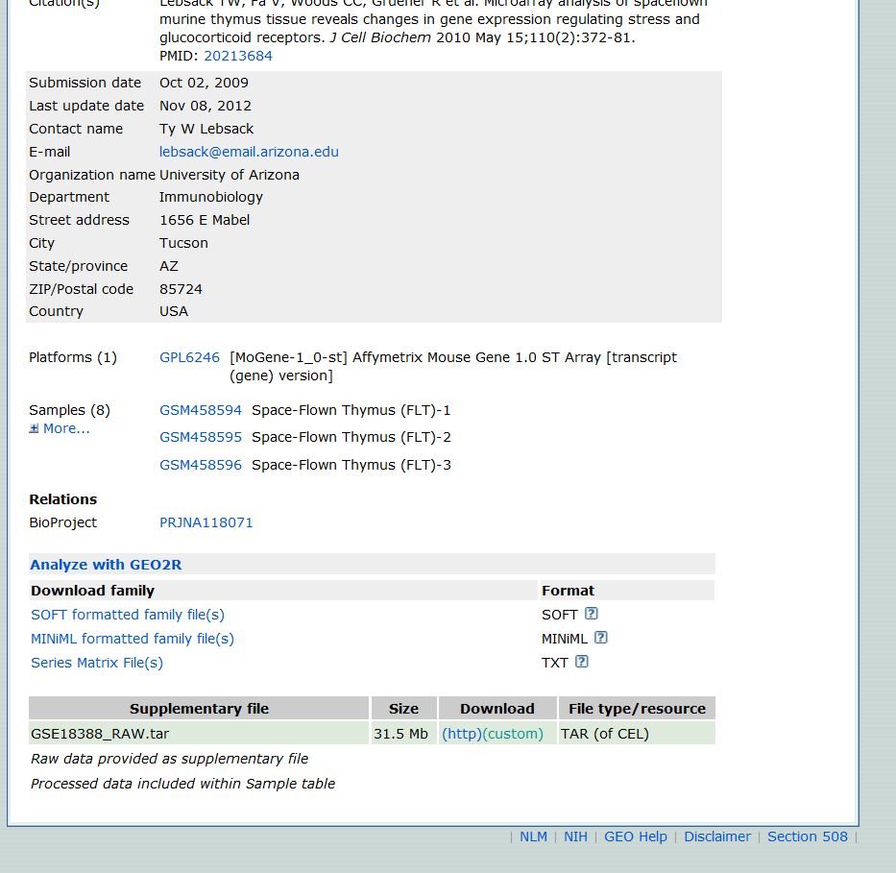
Click on
Link to
GEO2R

Slide 13
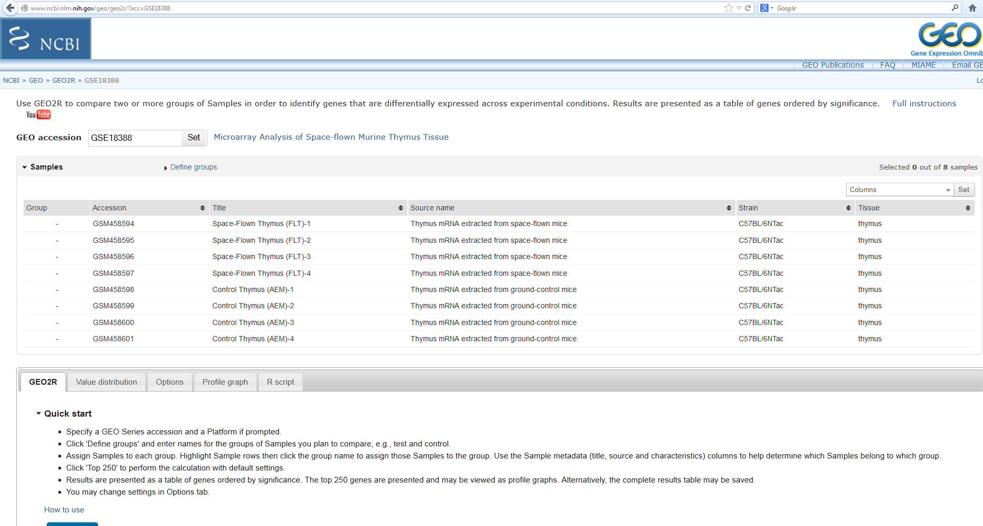
The R tool in GEO
Notes:
See FULL INSTRUCTIONS for information on stats tests

Slide 14
With help from Bioinformatics Shared Resource
Format and submit datasets to GEO
Large scale statistical analysis
Wide variety of analytical techniques (TFBS search)
Advanced data plotting for figures
Sequence Analysis (RNA-seq)
Notes:
Additional ways you could benefit from GEO include:

